Slide 1
WELCOME AUDIO BY PIR SENSOR |HOME AUTOMATION
Subtitle: Documentation
Author: LAV SAXENA,ISHANT LILA
Date: 9- SEPTEMBER -2024

Slide 2
PROJECT OVERVIEW :-
The project involves setting up a PIR sensor to detect motion and triggering an Arduino-based audio playback system to play a welcome message using a speaker. When someone enters the detection area of the PIR sensor, the Arduino will play an audio file stored on an SD card.

Slide 3
COMPONENT REQUIRED:-
Hardware:-
Audio Playback Module ( speaker system)
Microcontroller ( Arduino)
Power Supply
Connecting Wires
Transistor (BD139)
PIR sensor
SOFTWARE :-
Language:C++: The code uses Arduino-specific syntax and functions, which are essentially a subset of C++ tailored for embedded programming on microcontrollers.
Arduino IDE: The code should be compiled and uploaded to the microcontroller using the Arduino Integrated Development Environment (IDE). The IDE provides the necessary environment for writing, compiling, and uploading the code to an Arduino board

Slide 4
Libraries required:-
SD: This library is used to interact with SD cards. It allows reading and writing files to an SD card connected to the Arduino, which is necessary for audio playback in this context.
SPI: This library enables communication with devices using the SPI (Serial Peripheral Interface) protocol. It is essential for communication between the Arduino and the SD card module
TMRpcm: This library is used to play audio files (like .wav) using the Arduino. It works with the Arduino's hardware timer to generate audio signals through the digital I/O pins.SD: This library is used to interact with SD cards.

Slide 5
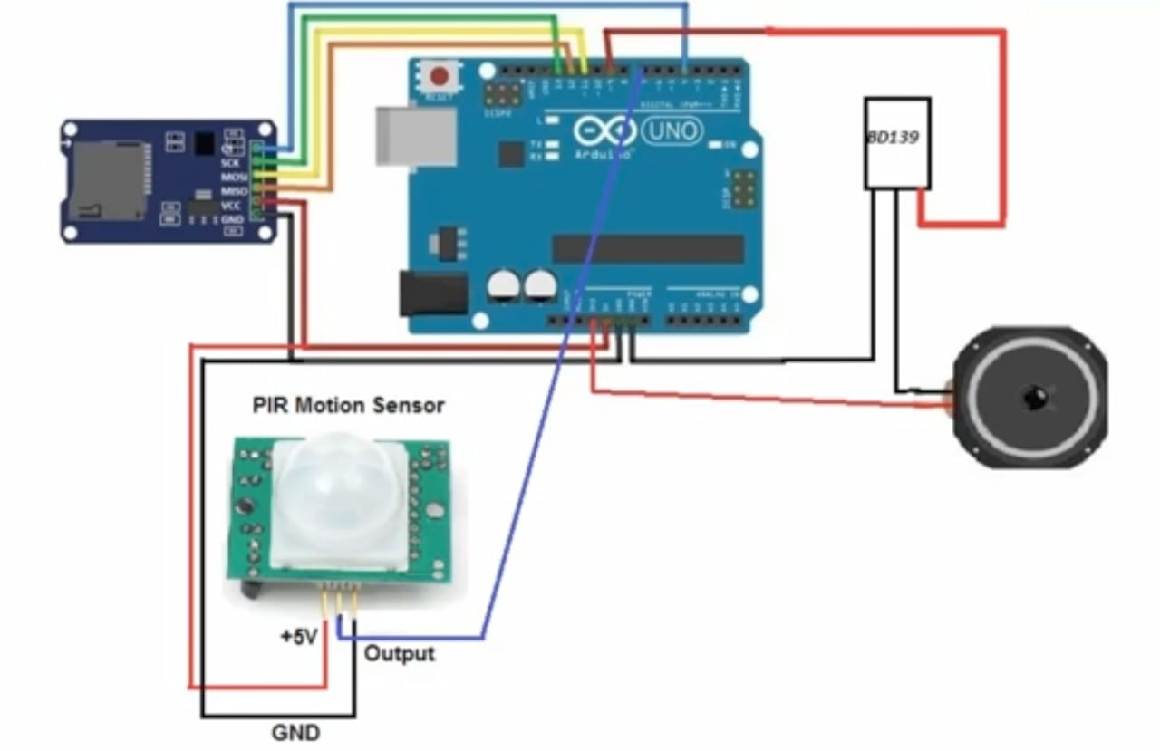
CIRCUIT DIAGRAM :-

